Slide 1
Telemetry meets SDN control
NETWORK FAULT DETECTION
Mininet + Ryu · baseline vs dynamic mode · PES University
Notes:
This project detects network faults by combining host telemetry with an SDN controller. I compare a baseline controller that only logs anomalies with a dynamic one that also reacts to them. Everything shown comes from the final evaluation run.

Slide 2
Three layers, one feedback loop
Hosts h1–h6
Switches s1–s3
Ryu controller
Agents send UDP telemetry every second: latency, probe loss, CPU.
OpenFlow 1.3 triangle with 10 Mbit trunks and a backup path.
Correlates telemetry with flow stats. Dynamic mode installs drop and reroute rules.
Notes:
Six hosts each run an agent that probes a peer and sends UDP telemetry to the controller every second. Three switches form a triangle with 10 Mbit trunks, so there is always a backup path. The Ryu controller combines the telemetry with flow and port statistics. In dynamic mode it also installs drop and reroute rules.

Slide 3
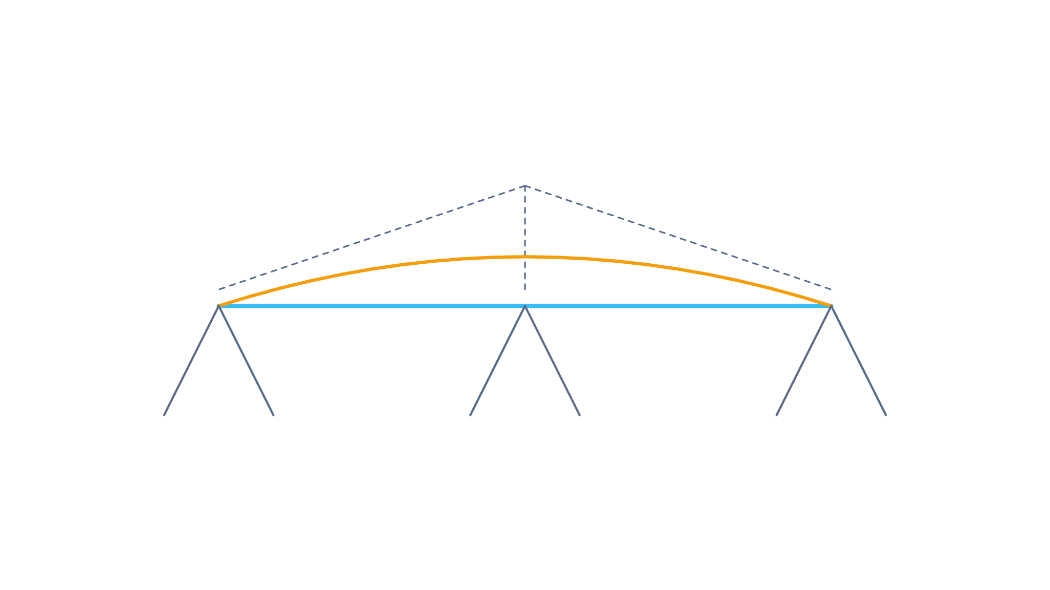
The evaluated topology
Ryu c0
s1
s2
s3
✕
h1
h2
h3
h4
h5
h6
Cyan: 10 Mbit trunks · Amber: backup path s1–s3 · Dashed grey: OpenFlow control · Red: link cut in the link-down fault
Notes:
This is the evaluated topology. h1 and h2 sit on s1, h3 and h4 on s2, and h5 and h6 on s3. The cyan links are the 10 Mbit trunks and the amber one is the backup path between s1 and s3. The dashed lines are the OpenFlow connections to the Ryu controller. The red mark is the access link we cut in the link-down scenario, h1 to s1. The other faults were a 50 Mbps UDP flood from h1 to h4, 200 ms of delay on h2, 30 percent loss on h3, and killing the agent on h5.

Slide 4
How the controller classifies a fault
Condition | Reported as
Latency above 30 ms, throughput above 8 Mbps | CONGESTION/FLOOD
Probe loss of 20% or more | PACKET LOSS
Latency above 30 ms, throughput normal | HOST/APP PROBLEM
No telemetry for 5 s, traffic still flowing | AGENT CRASH
No telemetry for 5 s, no traffic from the host | HOST/LINK DOWN
Notes:
These are the controller's rules, applied to each host. Missing telemetry is split by whether traffic is still flowing: if it is, the agent died; if not, the host or its link is down. When telemetry is present, high latency with high throughput means a flood, and high latency with normal throughput means a host or application problem. Packet loss is checked before the latency-only rule, which matters for the delay scenario.

Slide 5
Detection: first run vs final run
2/5
→
5/5
First run, both modes
Final run, both modes
Notes:
The first evaluation detected 2 of 5 faults in both modes: packet loss and the agent kill. After fixing the detection gaps, the final run detected all five in both modes. The fixes were made after seeing the failures, so I report both numbers instead of only the final one.

Slide 6
Four gaps, four fixes
Symptom | Cause | Fix
Flood missed | Queue delay of 60–84 ms stayed under the 100 ms limit | Latency threshold 30 ms
Delay seen as loss | A 200 ms delay exceeds the 0.2 s probe timeout | Agent timeout 0.6 s
Link down seen as agent crash | Cutting s1–s2 leaves hosts reachable; peer probes kept the host looking active | Cut h1–s1; count only traffic the host sends
Stale alerts scored | Alerts on other hosts counted as detections | Match the faulted host only
Notes:
Each fix is backed by a measurement. During the flood, round-trip time was 60 to 84 ms, under the old 100 ms threshold. The 200 ms delay exceeded the agent's 0.2 second probe timeout, so every probe counted as lost. Cutting a switch-to-switch link left every host reachable, and peer probes kept the host looking active, so the scenario now cuts h1's access link and a host counts as active only if it sends traffic or its own port carries traffic. Finally, the runner now accepts an alert only if it is on the faulted host.

Slide 7
Time to detect, in seconds
Fault | Baseline | Dynamic
UDP flood | 9.25 | 6.65
Added delay | 6.05 | 1.88
Packet loss | 3.83 | 4.45
Agent killed | 6.62 | 2.30
Link down | 8.64 | 9.35
One run per scenario and mode; differences between modes are within run-to-run variation.
Notes:
These are detection times in seconds, one run per scenario and mode. Dynamic was faster for delay and the agent kill, and slower for packet loss and link down. Both modes run the same detection code, so I treat the differences as run-to-run variation, likely from the 5 second statistics polling. I would need repeated runs to say more than that.

Slide 8
What the data shows
Both modes detect all five faults on the final code.
Dynamic mode showed no recovery benefit in this evaluation.
Recovery time mostly reflects fault duration, so it is not reported.
Each result is a single run.
Notes:
Both modes detect all five faults on the final code. I did not find a recovery benefit from dynamic mitigation. The recovery metric mostly measures fault duration, so I do not report it. In the packet-loss scenario the runner's own probe showed no loss, and I did not find out why. If asked: flood recovery in dynamic mode was slower, possibly because of the 30 second drop rule, but I did not check that. Each result is a single run.

